Slide 1

Class and Objects

Slide 2
Introduction to class and objects
Python is an object-oriented programming language. Unlike procedure-oriented programming, where the main emphasis is on functions, object-oriented programming stresses on objects.

Slide 3
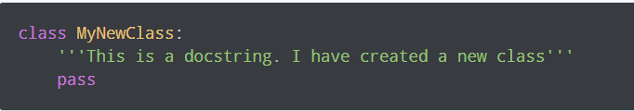
Defining a Class in Python
Like function definitions begin with the def keyword in Python, class definitions begin with a class keyword.

Slide 4
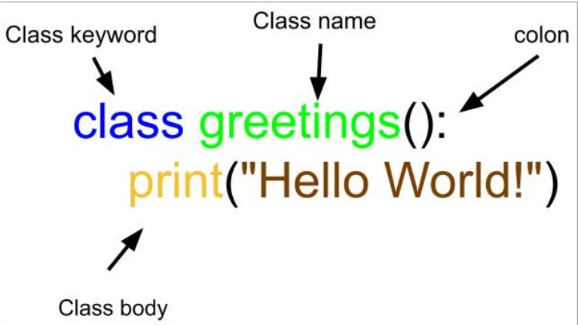

Slide 5
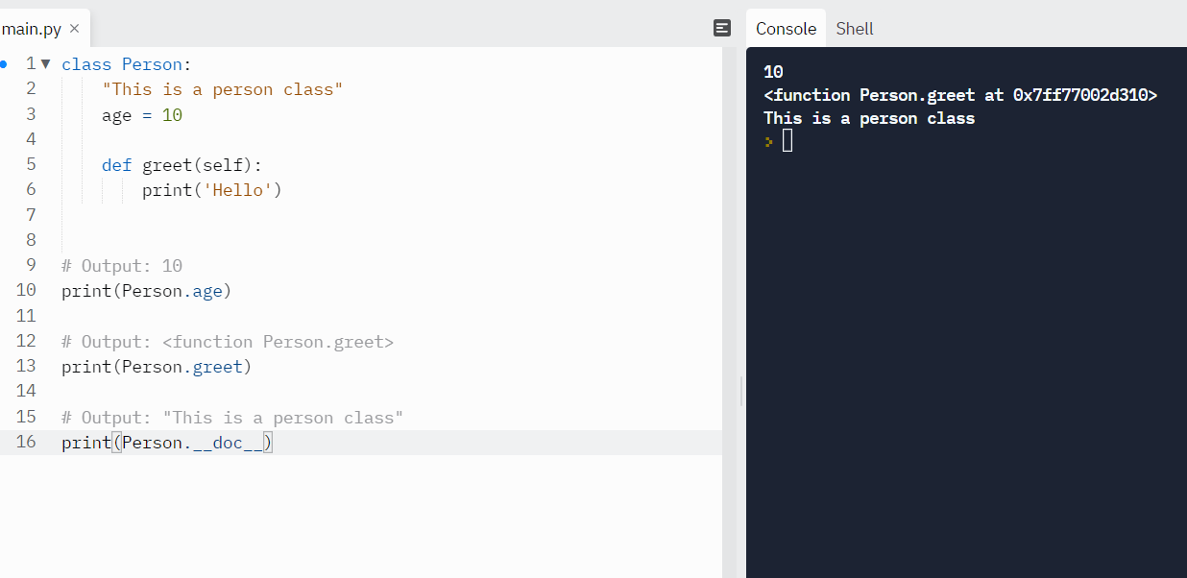

Slide 6
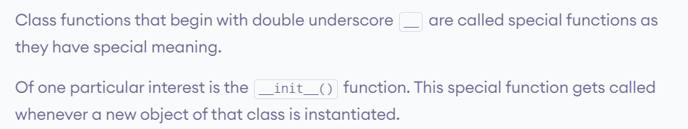
Constructors in Python

Slide 7
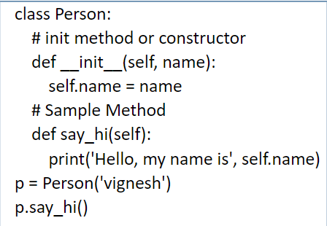
__init__ method
__init__ method
The __init__ method is similar to constructors in C++ and Java. Constructors are used to initializing the object’s state. Like methods, a constructor also contains a collection of statements(i.e. instructions) that are executed at the time of Object creation. It runs as soon as an object of a class is instantiated. The method is useful to do any initialization you want to do with your object.

Slide 8
What Is Object-Oriented Programming
OOP permits us to bundle similar properties and behaviors into containers. In Python, these containers are called Classes. A class presents to the real-world an instance of itself called Objects.
OOP was designed to address some important principles like Modularity, Abstraction, and Encapsulation.

Slide 9
Continue
Modularity
Modern software commonly consists of several different components that have unique responsibilities and interact with each order for the proper functionality of the entire system.
Modularity in OOP refers to grouping components with related functionality into a single unit. This helps in robustness, readability, and reusability.

Slide 10
Abstraction
Abstraction is the process of hiding a method’s real implementation and only exposing its required characteristics and behavior.
As a real-world example, let’s consider our mobile phones. In order to make a call, we dial the number or select a contact and press the call button. All we know is that a call is made but we don’t know and we may not care about all the background processes that take place for the call to be successful.

Slide 11
Encapsulation
Encapsulation in OOP allows programmers to restrict access to chosen components (attributes and methods) from being accidentally accessed or depended upon.
This gives a programmer the freedom to implement these components without the concern that other programmers will write code that depends on them.

Slide 12
Class Inheritance
  In modern software development, it is common to organize various structural components of the software in a hierarchical fashion. This organization is done in a level-by-level manner with an “is a” relationship between levels.

Slide 13
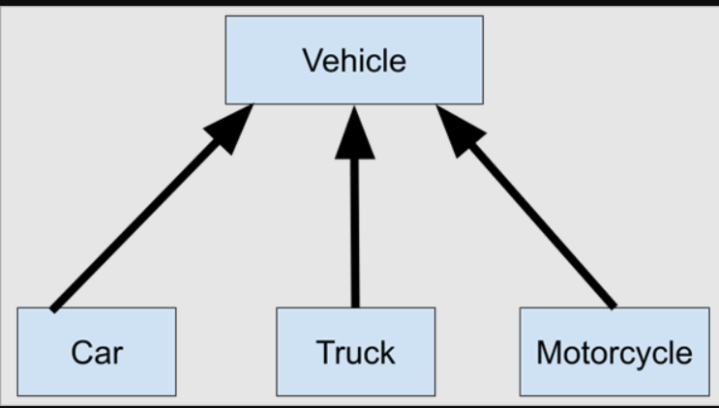

Slide 14
code
# A Python program to demonstrate inheritance
class Person(object):
# Constructor
def __init__(self, name):
self.name = name
# To get name
def getName(self):
return self.name
# To check if this person is an employee
def isEmployee(self):
return False

Slide 15
# Inherited or Subclass (Note Person in bracket)
class Employee(Person):
# Here we return true
def isEmployee(self):
return True
# Driver code
emp = Person("Geek1") # An Object of Person
print(emp.getName(), emp.isEmployee())
emp = Employee("Geek2") # An Object of Employee
print(emp.getName(), emp.isEmployee())

Slide 16
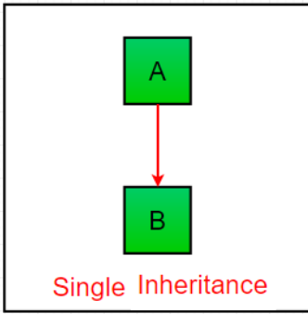
Types of Inheritance in Python
Single Inheritance: Single inheritance enables a derived class to inherit properties from a single parent class, thus enabling code reusability and the addition of new features to existing code.

Slide 17
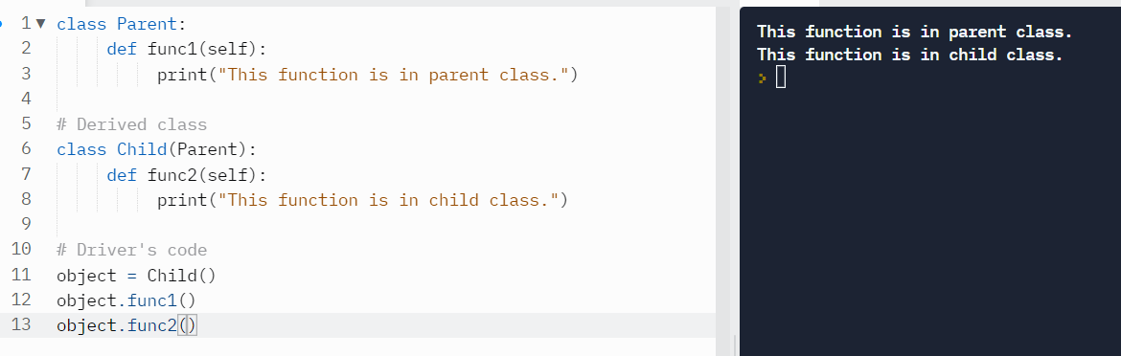
Example

Slide 18
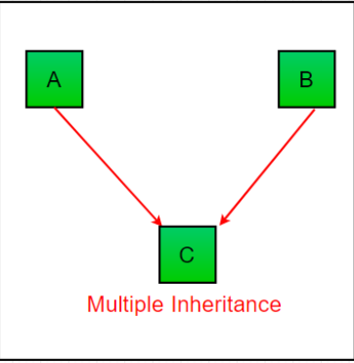
Multiple Inheritance:
When a class can be derived from more than one base class this type of inheritance is called multiple inheritance. In multiple inheritance, all the features of the base classes are inherited into the derived class.

Slide 19
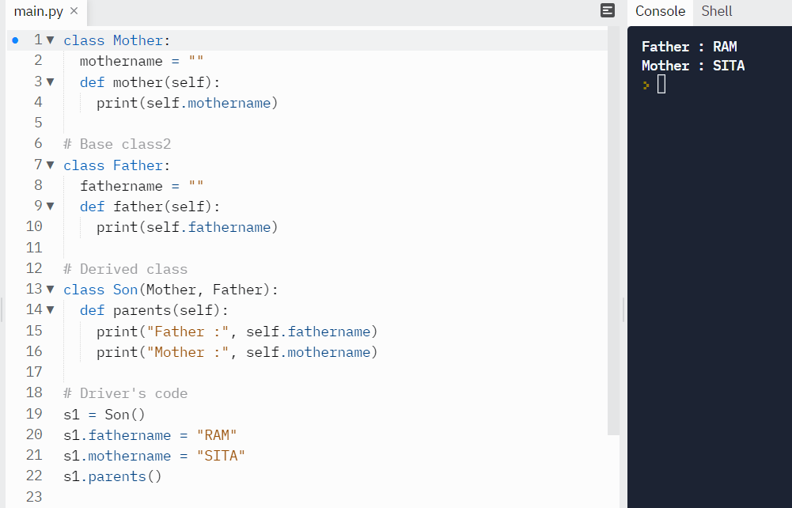

Slide 20
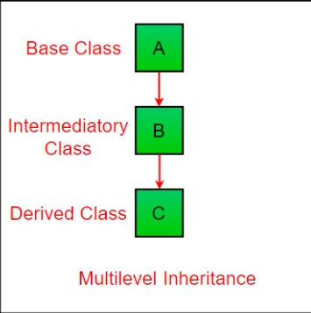
Multilevel Inheritance
In multilevel inheritance, features of the base class and the derived class are further inherited into the new derived class. This is similar to a relationship representing a child and grandfather.

Slide 21
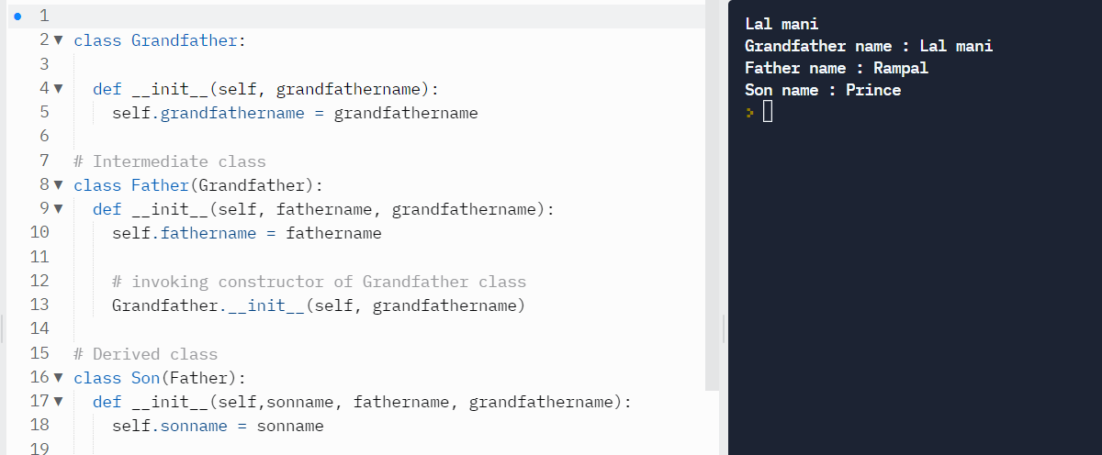

Slide 22
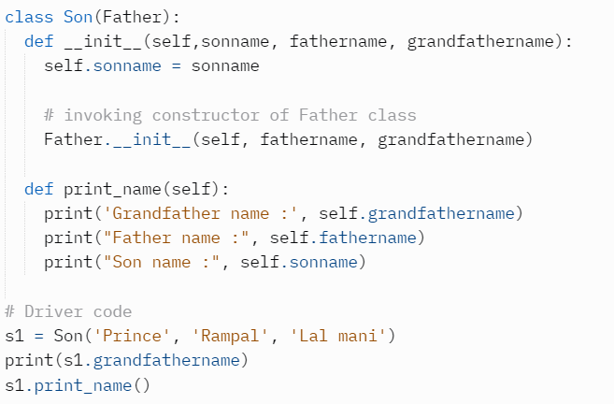

Slide 23
Hierarchical Inheritance:
When more than one derived classes are created from a single base this type of inheritance is called hierarchical inheritance. In this program, we have a parent (base) class and two child (derived) classes.

Slide 24
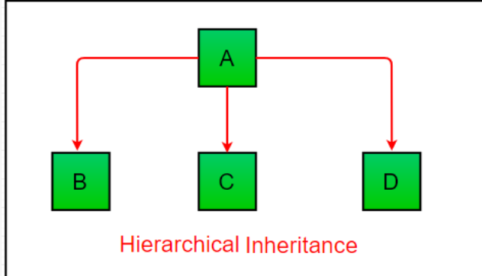

Slide 25
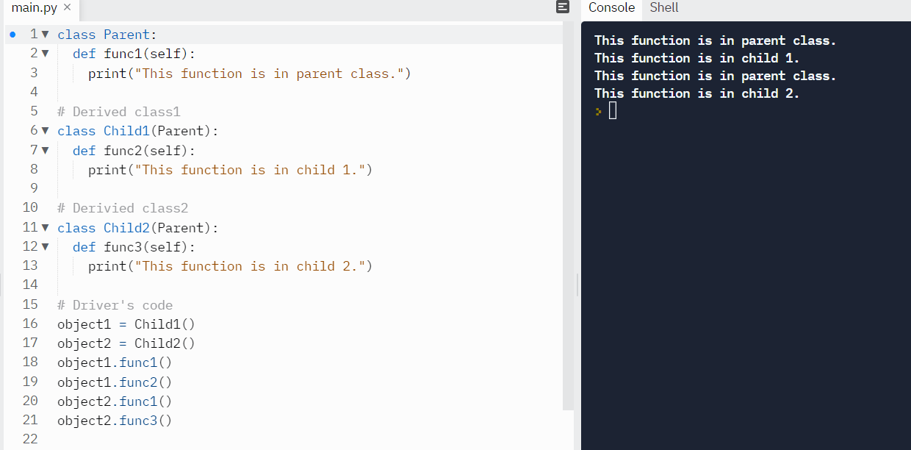

Slide 26
Encapsulation in Python
Encapsulation is one of the fundamental concepts in object-oriented programming (OOP). It describes the idea of wrapping data and the methods that work on data within one unit.
This puts restrictions on accessing variables and methods directly and can prevent the accidental modification of data. To prevent accidental change, an object’s variable can only be changed by an object’s method. Those types of variables are known as private variables.

Slide 27
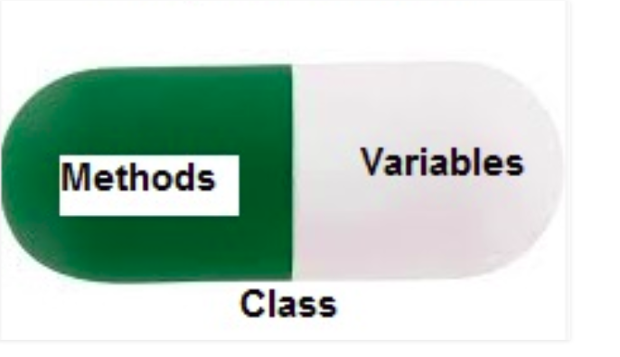

Slide 28
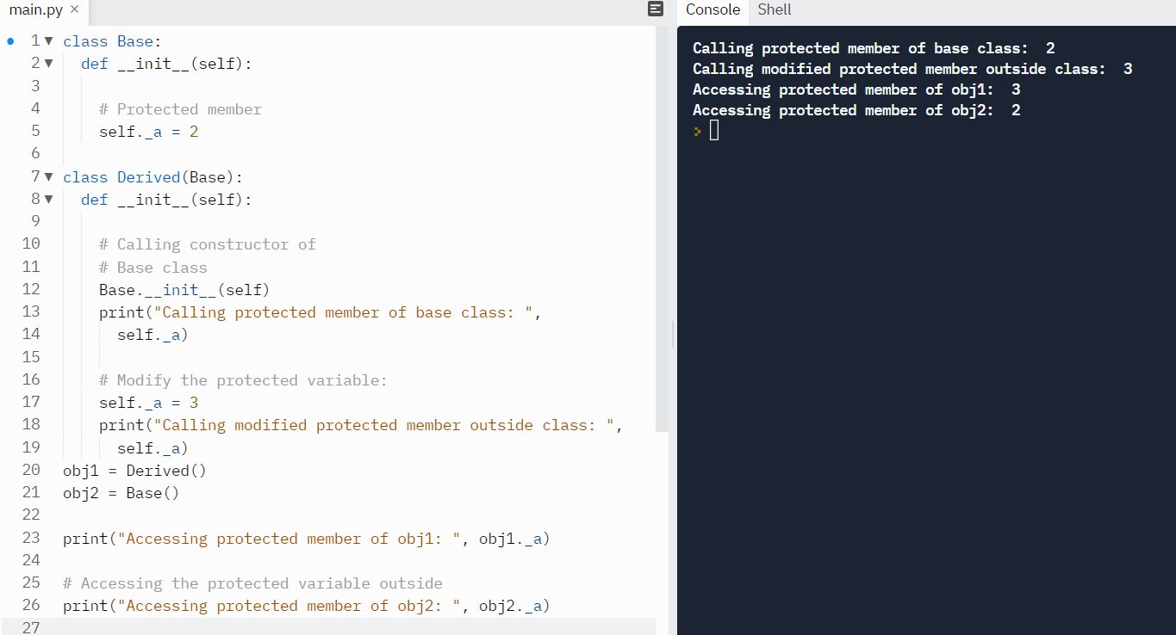

Slide 29
Polymorphism in Python
The word polymorphism means having many forms. In programming, polymorphism means the same function name (but different signatures) being used for different types.

Slide 30
